Slide 1

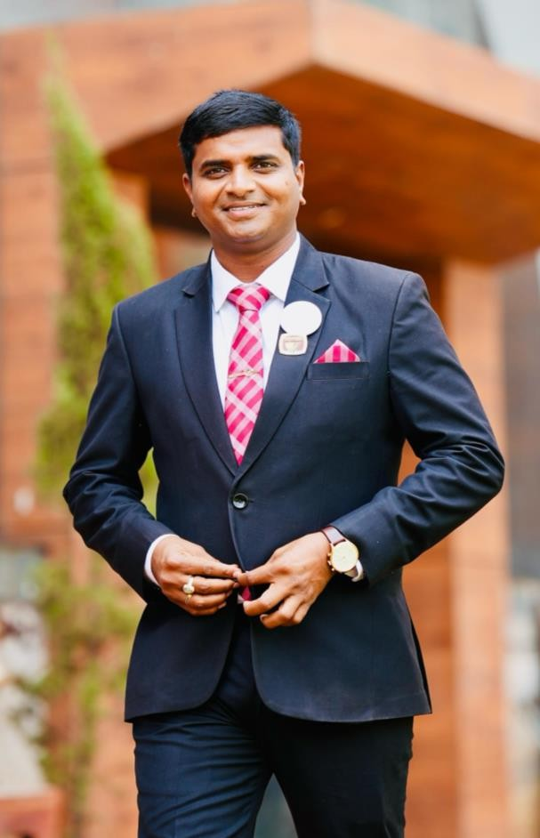


RIGHT DUPLICATION
SRINIVAS VADDEMANU
(DUCD)

Slide 2
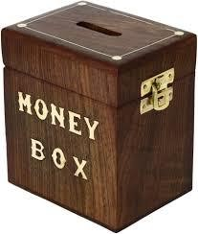


INVESTMENT BOX

Slide 3




SELF CONSUME OUR PRODUCTS

Slide 4
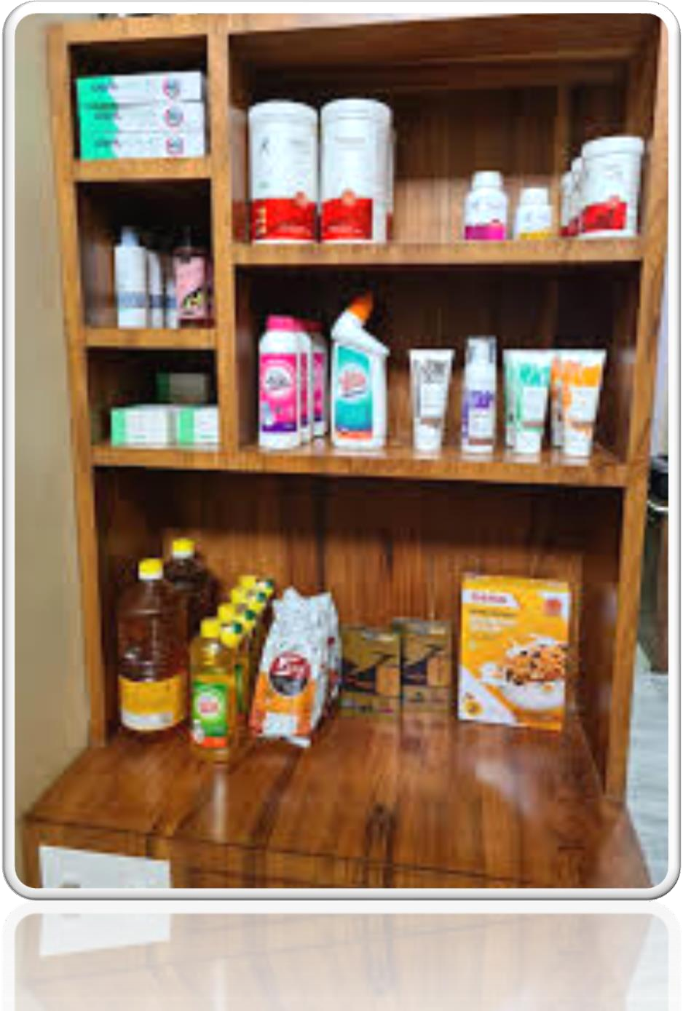

MAGIC CORNER

Slide 5
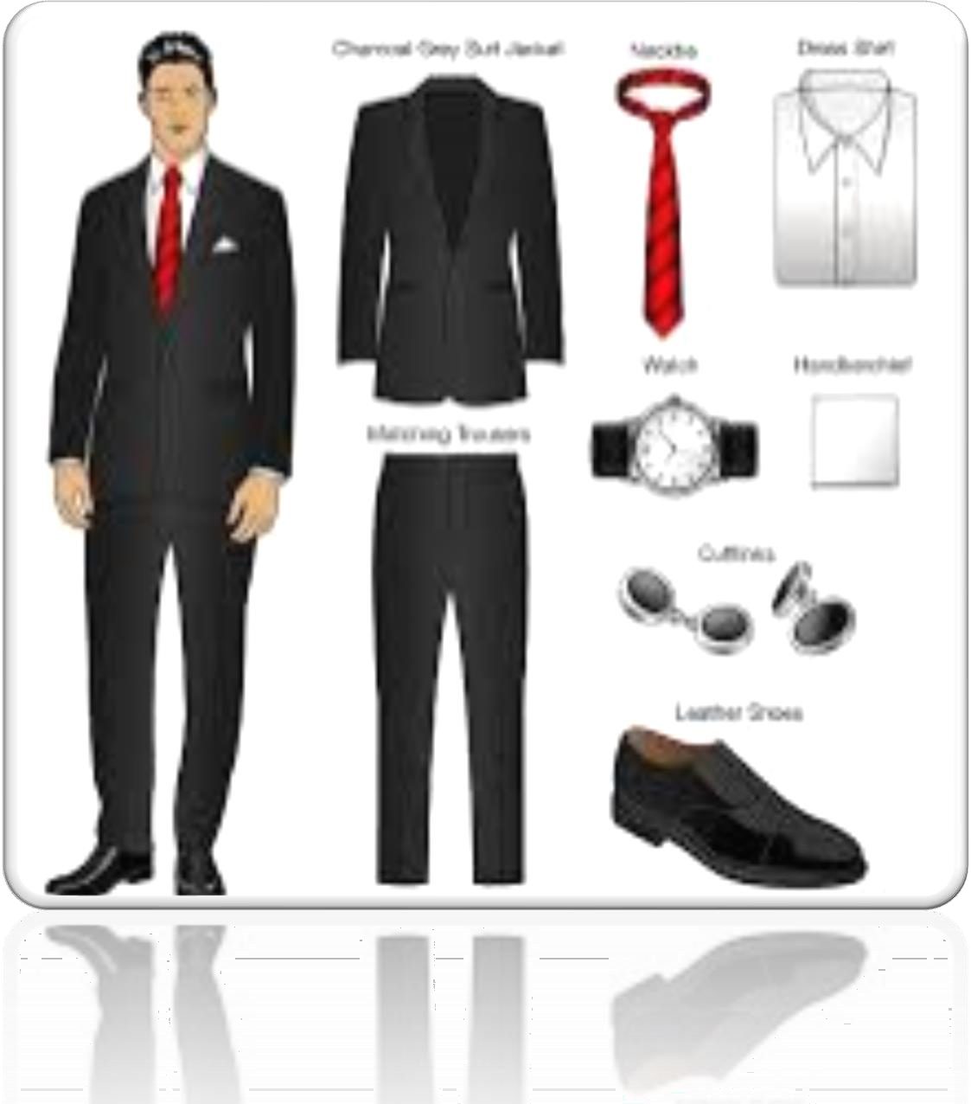

DRESS CODE

Slide 6





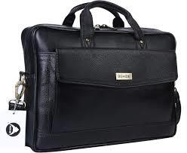

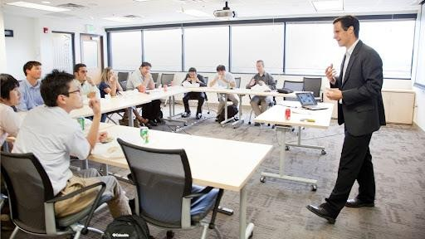


SELF (STP) SHOW THE PLAN
CARRY THE DEMO KIT

Slide 7






KIT OPENING
HOME MEETING

Slide 8


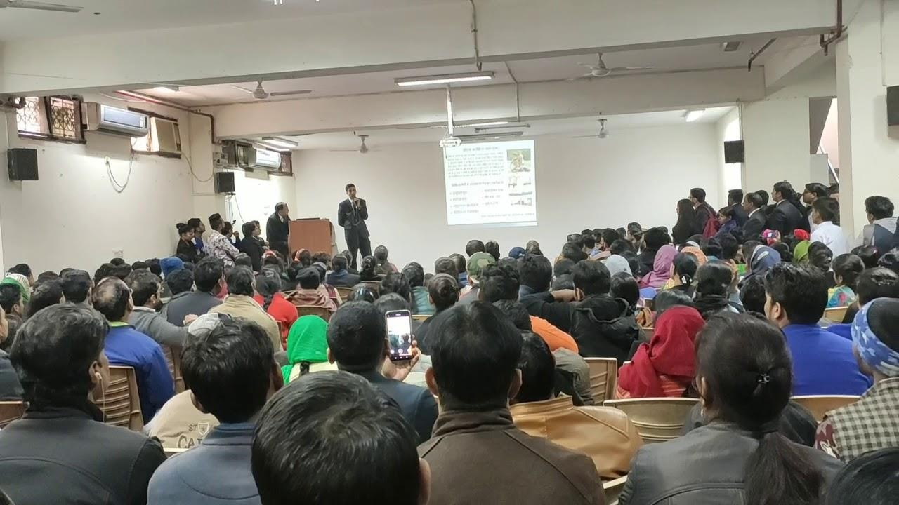
ATTEND ALL MEETINGS

Slide 9

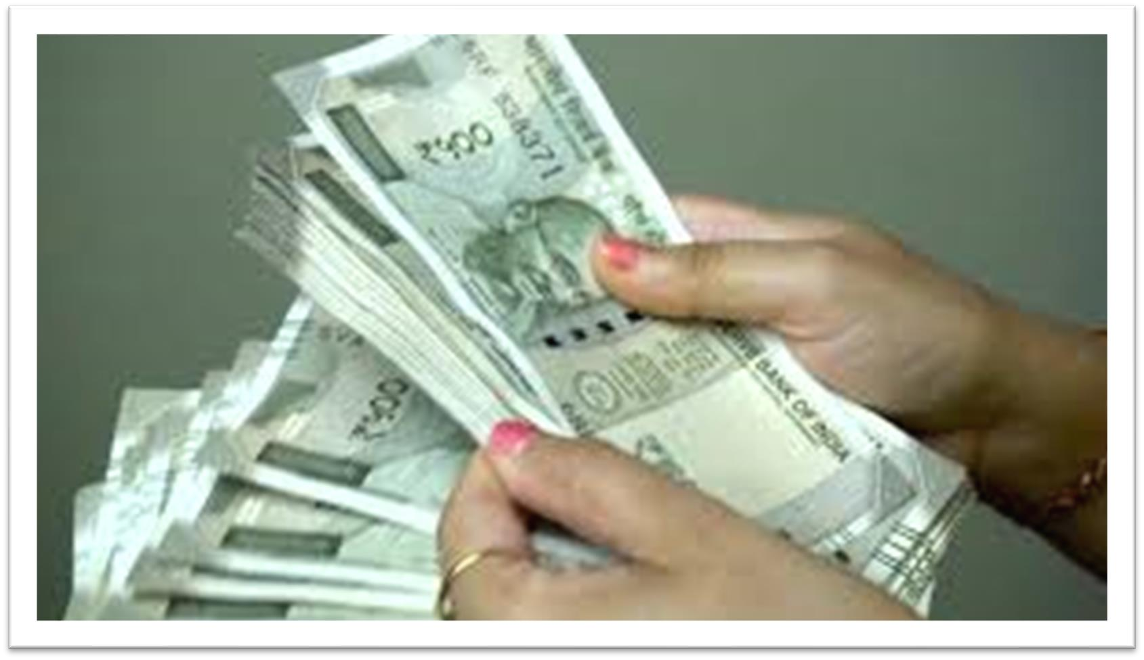
NO MONEY INVOLVE

Slide 10






FOLLOW THE WT SYSTEM & GROWING UPLINE

Slide 11



SRINIVAS VADDEMANU
(DUCD)

